Slide 1
Lab 2 - HMMs
HMM with Gaussian Emissions

Slide 2
First step: Concat HMMs
This is done to “connect” to two HMMs to each other. This allows the model to handle more sophisticated scenarios or processes than could be managed by a single HMM.
Note: Each observation is a continuous stochastic variable (MFCC). If the segment is sufficiently short then we can model it with HMMs.

Slide 3
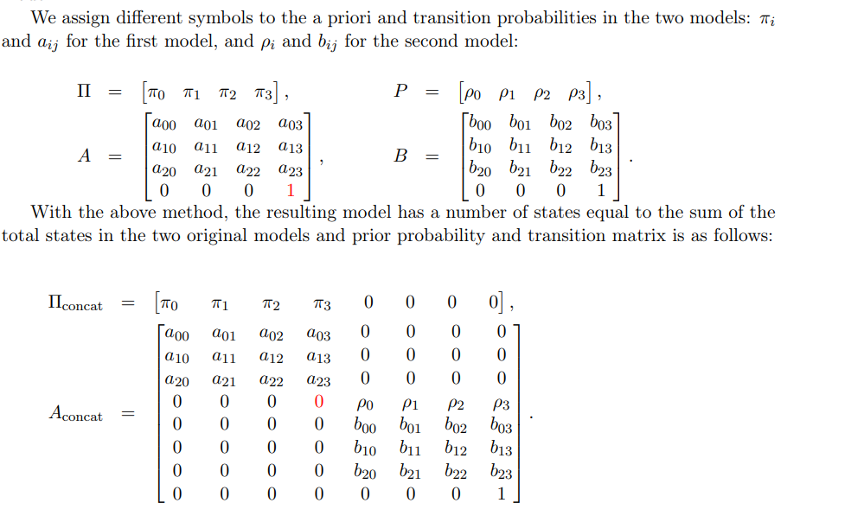
First step: How to do it?
We did it as in the concat.pdf
Add a non-emitting state on both HMM.s
“Stack zeroes” on both Hmms. On the “first HMM” stack it at the tail. On the second “ from the top”.
Final matrix A is two Hmms + 2. Concat HMM 1 + HMM 2 together
Stack the means, covariance, startprob + transition matrix

Slide 4
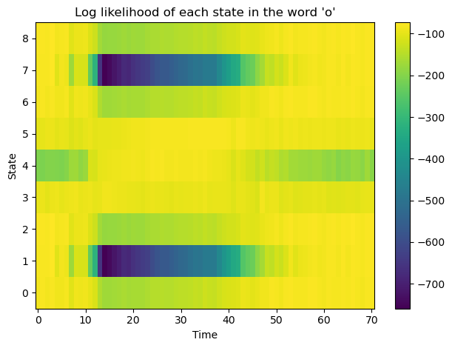
Log likelihood for Gaussian from HMM
This figure represents the log likelihood for each state in the word ‘o’ State 7 and 1 seems the most likely.
The states corresponds to ‘pronunciations’ but exactly which ones 7 and 1 are, are unknown.

Slide 5
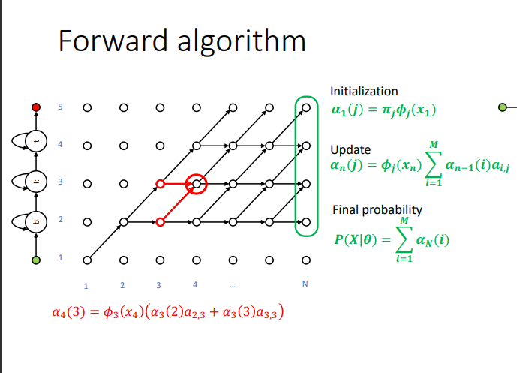
Forward Algorithm
Given the observed sequence of events, calculate the probability of being in a particular state at a certain point in time.
Sum-product in Bayesian Networks. “Sum up all previous states” and find the most probable one

Slide 6
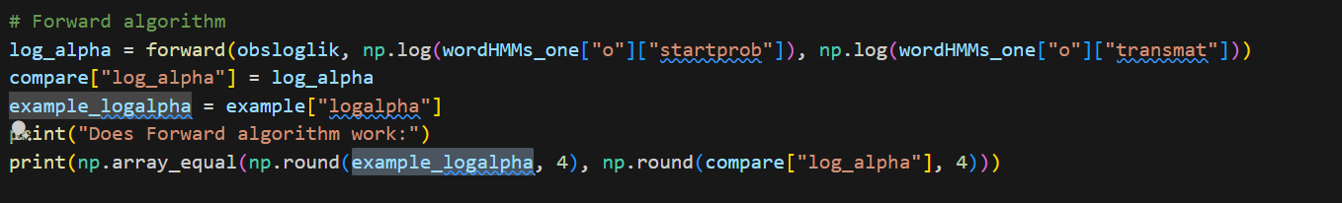

Forward Algorithm
Here we simply calculated forward and obtained log alpha array then compare it with the example. They became identical

Slide 7
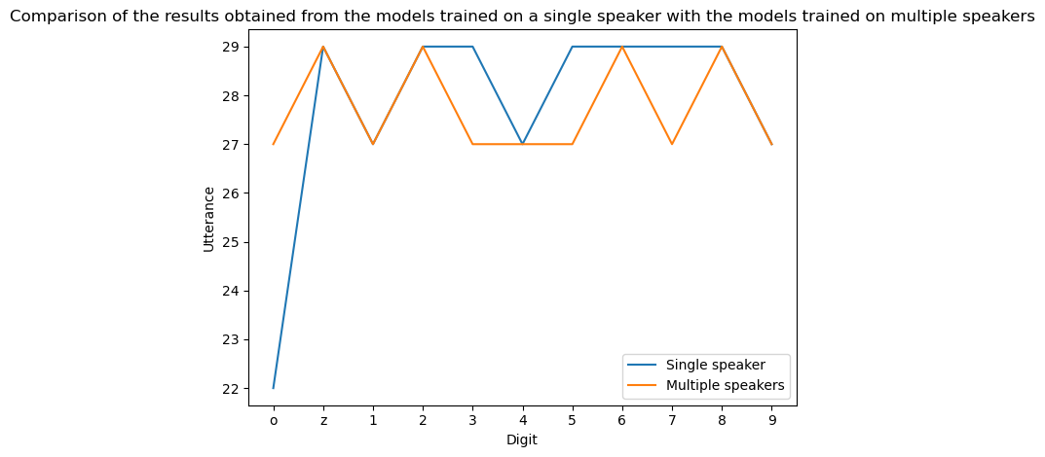
Forward - Score all 44 utterances with 11 Hmms
This question in the assignment was unclear but also hard to code: This is our results when scoring 44 utterances in the data array with 11 HMM models vs 1 speaker HMM.
Long story short: We cannot really find/think of mistakes if we take the max log likelihood model as the winner. There probably is one but we didn’t think of it.

Slide 8
Viterbi
Viterbi Algorithm algorithms calculates the most likely sequence of hidden states that generated a given sequence of observation. Basically find the sequence of states that generated a given sequence of observations.
Compared with forward: Forward tells us “what the next state will be” given the observations. This tell us which states has led us here. so far.
Thereby you need to store all the “Max probs” of each observation for “backtracking purposes”

Slide 9
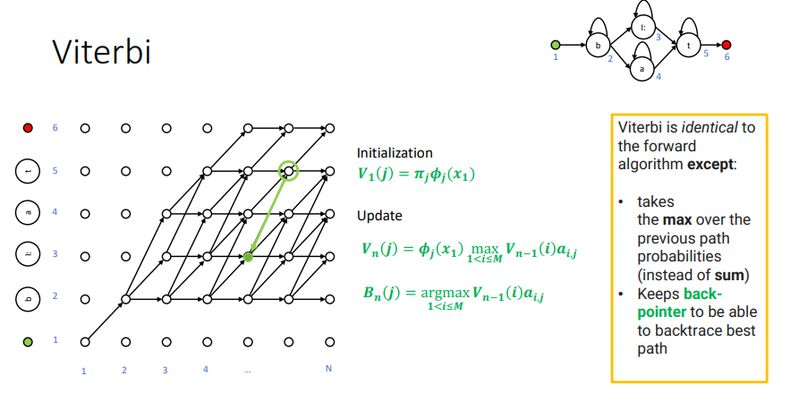
Viterbi implementation
def viterbi(log_emlik, log_startprob, log_transmat, forceFinalState=True):
"""Viterbi path.
Args:
log_emlik: NxM array of emission log likelihoods, N frames, M states
log_startprob: log probability to start in state i
log_transmat: transition log probability from state i to j
forceFinalState: if True, start backtracking from the final state in
the model, instead of the best state at the last time step
Output:
viterbi_loglik: log likelihood of the best path
viterbi_path: best path
"""
viterbi_loglik = np.zeros(log_emlik.shape)
viterbi_backtrack = np.zeros(log_emlik.shape)
# Initialize the first row of the viterbi log likelihood matrix
for j in range(viterbi_loglik.shape[1]):
viterbi_loglik[0][j] = log_startprob[j] + log_emlik[0][j]
# Here we calculate the viterbi log likelihood matrix by taking the max of the previous row and adding the transition matrix
for t in range(1, viterbi_loglik.shape[0]):
for s in range(viterbi_loglik.shape[1]):
viterbi_loglik[t, s] = (
np.max(viterbi_loglik[t - 1, :] + log_transmat[:, s]) + log_emlik[t, s]
)
viterbi_backtrack[t, s] = np.argmax(
viterbi_loglik[t - 1, :] + log_transmat[:, s]
)
viterbi_path = []
viterbi_path.append(np.argmax(viterbi_loglik[-1]))
# Backtracking and grabbing the best path
for n in reversed(range(viterbi_backtrack.shape[0] - 1)):
viterbi_path.append(int(viterbi_backtrack[n][viterbi_path[-1]]))
viterbi_path.reverse()
return np.max(viterbi_loglik[-1]), viterbi_path
Intuitive explanation: Given a state: which previous state was most likely to generate it? Store that state’s index in backtrack
Use backtrack to generate the path.

Slide 10
Viterbi verification
Compute Viterbi log likelihoof for wordHMM[‘o’] and example[‘lmfcc’] and verify that you obtain the same result as in the example[‘vloglik’]
print("Does Viterbi algorithm work:")
viterbi_loglik, path = viterbi(
obsloglik,
np.log(wordHMMs_one["o"]["startprob"]),
np.log(wordHMMs_one["o"]["transmat"][:-1, :-1]),
)
print(np.array_equal(np.round(viterbi_loglik, 1), np.round(example["vloglik"], 1)))
Does Viterbi algorithm work:
True

Slide 11
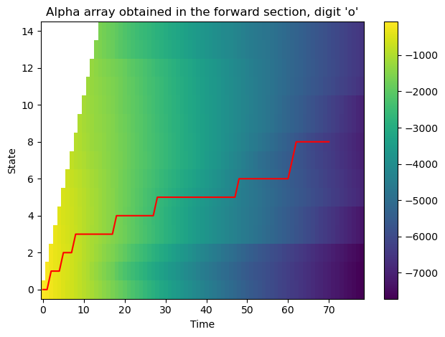
Viterbi - Best path
Log alpha generated from the forward path.
The red is the viterbi path.

Slide 12
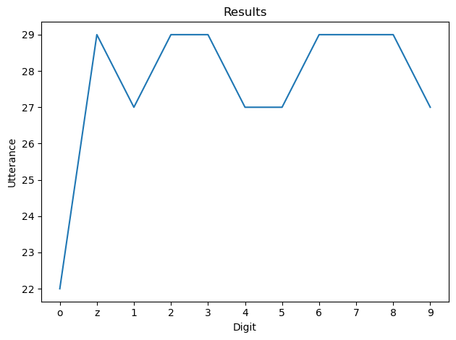
Mistakes counted if winner is model with max viterbi
Very similar to Forward Don’t know why they are the same.
Regarding CPU usage: Seems that Viterbi is better as it uses dynamic programming. Both are equally computationally expensive however because of dynamic programming Viterbi uses less CPU

Slide 13
Backward Algorithm verification
Does Backward algorithm work:
True
def backward(log_emlik, log_startprob, log_transmat):
"""Backward (beta) probabilities in log domain.
Args:
log_emlik: NxM array of emission log likelihoods, N frames, M states
log_startprob: log probability to start in state i
log_transmat: transition log probability from state i to j
Output:
backward_prob: NxM array of backward log probabilities for each of the M states in the model
Formula from the slides:
Log (β[T-1][i]) = log(1) = 0
Log (β[t][i]) = log(Σj=1->N(a[t][j] * b[j](X[t+1]) * β[t+1][j]))
Where a is the transition matrix, b is the emission matrix, and β is the backward matrix
"""
backward_probs = np.zeros(log_emlik.shape)
for timestep in reversed(range(backward_probs.shape[0]-1)):
for i in range(backward_probs.shape[1]):
backward_probs[timestep ,i] = logsumexp(log_transmat[i,:-1] + log_emlik[timestep+1,:] + backward_probs[timestep+1,:])
return backward_probs
Part 5.4 in the assignment: Verify that we obtain log beta arrays as in the example
which we did
logbeta[i,j] where i is the timesteps and j is the states in the model

Slide 14
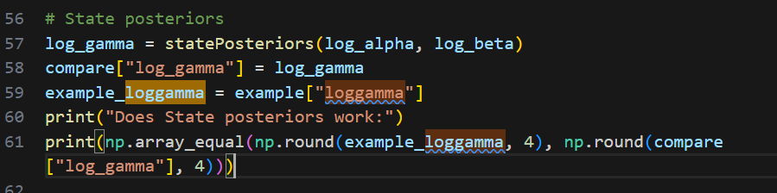
State Posterior Probabilities
Verify that for each timestep the state posterior sum to one in linear ompain.
Does State posteriors work:
True

Slide 15
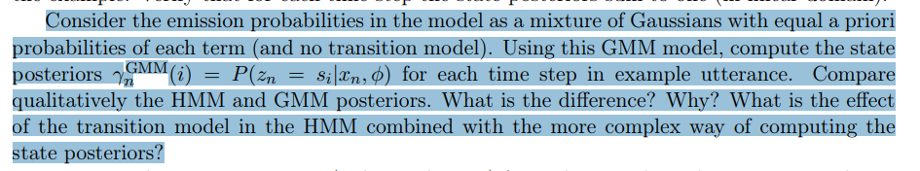
HMM vs GMM Posterior differences
Difference:
HMM considers the dependencies between states through its transition model which makes the next state (posterior) dependent on the sequences. GMM ignores such dependencies by treating each observation independently.
This makes HMM computation more expensive due to recursive dependency on previous posterior and transition. GMM is more straightforward
In the context of Speech recognition: HMM as there is temporal differences. In the context of Characteristics modelling: I’d say HMM as it is effective in modeelling the distribution of the features extracted from speaker’s voices.

Slide 16
Summing up HMM posteriors. What does it mean
Summing for each state along the time axis: This gives the expected number of times the system s is it state s_{i} through the entire sequence. “How much time did we spend in this particular state”
Summing over all states and time: Gives you the sequence length T and represents the number of steps in the sequence.

Slide 17
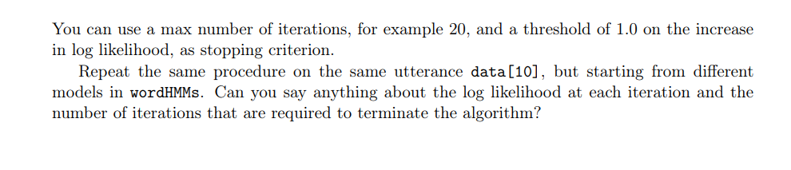
Last part - Baum Welch algorithm

Slide 19
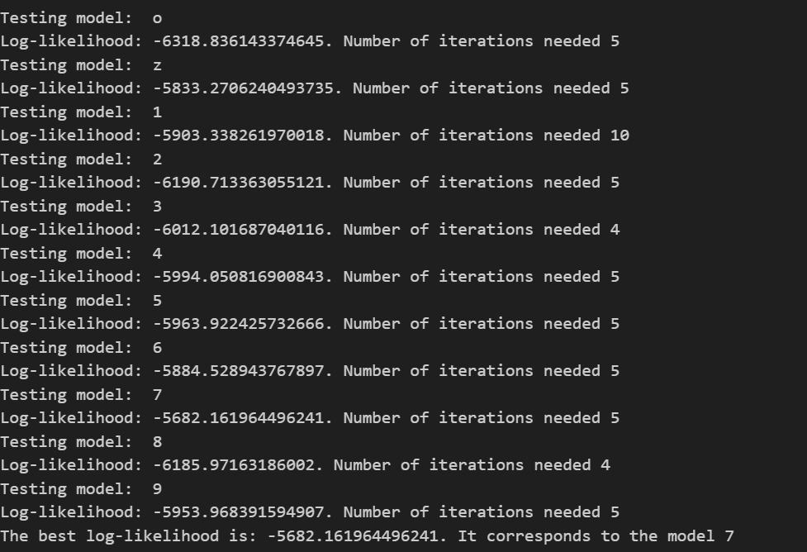
Last answer
Model 7 HMM seems to fit the data best although still kinda bad -log results
Most of stopped fbefore 20 iterations with the “break criteria” of 20 iterations and a threshold of 1.0 on the increase in log likelihood.
Observe that most of HMM are not far off.

